Slide 1
INGEST REQUIREMENTS CHECKLIST
By Dmytro Dragan

Slide 2
Ingest is simple, right?

Slide 3
Ingest is simple (NO)

Slide 4
How detailed requirements should be?

Slide 5
How detailed requirements should be?
Good

Slide 6
Feature-driven blind agile
So let`s start from this one…
Now they want this one as well…
New request – new flag…
We will make spike and
figure out later
We will make spike and
figure out later

Slide 7
Requirements
For Source
For Transformations
For Target

Slide 8
Let`s start from source system
Source System API
Push / Pull
Security

Slide 9
Let`s start from source system
Source System API
Push
Note:
Each Push bring
internal Pull
(backpressure, throttling)

Slide 10
Let`s start from source system
When to extract data ?
time-based
trigger-based (event-based, One-time-delivery, Only God knows)

Slide 11
Story 0 – Is it really time-based?
„We will provide file in last day of month at 1 a.m. CET” Customer

Slide 12
Story 0 – Is it really time-based?
„We will provide file in last day of month at 1 a.m. CET,
if it will be weekend day, then in first working day.” Customer

Slide 13
Story 0 – Is it really time-based?
„We will provide file in last day of month at 1 a.m. CET,
if it will be weekend day, then in first working day.
If it will be bank holiday in Sweeden, then next working day.” Customer

Slide 14
Story 0 – Is it really time-based?
„We will provide file in last day of month at 1 a.m. CET,
if it will be weekend day, then in first working day.
If it will be bank holiday in Sweeden and files comes from Swedish MF system (you will need parse it first to get header with Sweden code), then next working day.
If it will be bank holiday in Norway and files comes from Norway MF system (you will need parse it first to get header with Norway code), then next working day.”” Customer

Slide 15
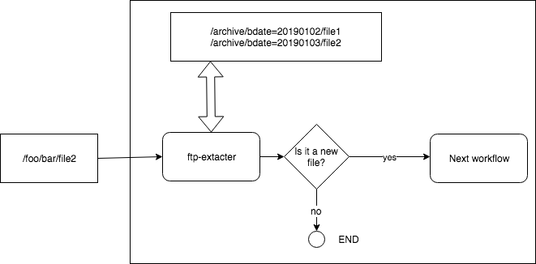
Story 0 – Is it really time-based?

Slide 16
Let`s start from source system
Data size distribution
Form: uniform / skewed
Average sizes

Slide 17
Story 1 – Spark is Gold Hammer
”There will be a large files, so we definitely need Spark” Customer
Small < 1 KB
Large > 1 GB

Slide 18
Let`s start from source system
Is input data append-only?
Full ingest
Incremental
Mix of both

Slide 19
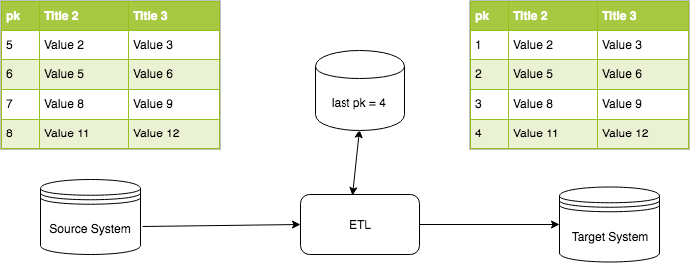
Story 2 – It is a simple JBDC source, you already suport it
Incremental Append-only

Slide 20
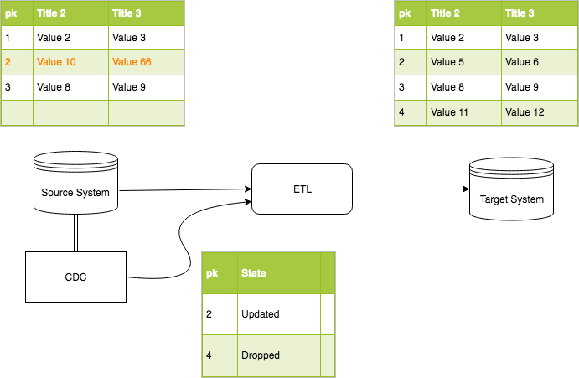
Story 2 - It is a simple JBDC source, you already suport it
Incremental
Snapshoting
with CDC

Slide 21
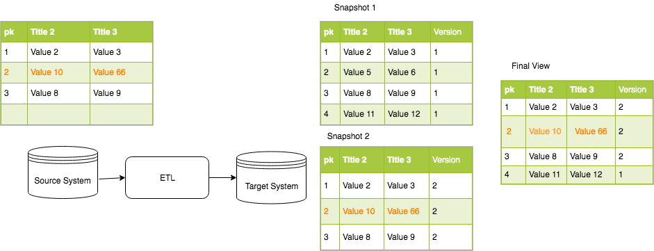
Story 2 - It is a simple JBDC source, you already suport it
Incremental
Snapshoting
with Merge

Slide 22
Let`s start from source system
How long dataset will be available?
Number of parallel connectors
Read window

Slide 23
NEXT: source data
Data format
schemaful / schemaless
Splittable
Metadata/Specification ( timestamps, watermarks, business dates etc)

Slide 24
Transformations
Do you have dependencies ?
State
Fan-In/Fan-Out
Variety
Field Mapping

Slide 25
Story 4 – The Great Field Names
FILLER (duplicated 10 Times)
„THE SOME STRANGE FIELD”
Døðr / Колонна / 檐柱
02FIELD ( say ”HI” to AVRO)
…

Slide 26
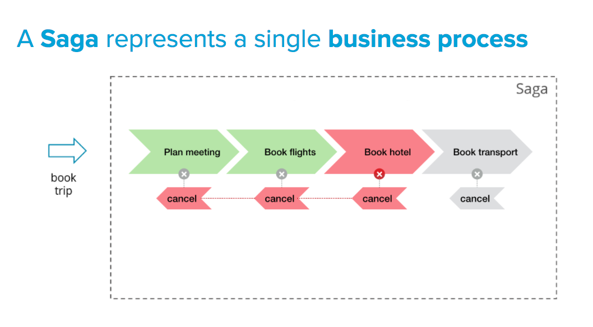
Additional flows
Exception flow
Investigation flow

Slide 27
What about our target?
Now you are source system ☺
End-User Delivery Interfaces
Complience
Is there are sensitive data?
SLA

Slide 28
Who else is your stakeholder?
Data Governance / Data Quaility
Data Lineage / Data Catalog
Monitoring/ Log management

Slide 29
Thank you
Any Questions?

